Slide 1
Re-Structuring, Rightsizing Downsizing, & Smartsizing
Cdr Vijay Pratap Singh
Adjunct Professor, E&TC

Slide 2
CONTENTS
Restructuring
Rightsizing
Downsizing
Smart sizing

Slide 3
Restructuring (for business sustainability)
What is restructuring?
Restructuring is a term used to describe circumstances where companies decide to make changes to business models, business operations, structural organization or financial spending.
On a smaller scale, restructuring can also occur at the department level, where department managers reorganize roles, priorities and department budgets.

Slide 4
Restructuring
Restructuring is when a company makes significant changes to its financial or operational structure, typically while under financial restriction/duress.
Companies may also restructure when preparing for a sale, buyout, merger, change in overall goals, or transfer of ownership.
Restructuring involves fundamental changes in a business's activities and resources.

Slide 5
Benefits of Restructuring
Levels business with competitors
Enhances communication
Increases employee productivity
Maintains or improves company finances
Provides opportunities for business growth

Slide 6
Types of restructuring
Legal restructuring
Turnaround restructuring- replace product line
Cost restructuring- cost saving
Repositioning restructuring- expansion of business by diversifying products
Spin-off restructuring- process by which a company makes one or more branch locations
Divestment
Mergers and acquisitions
Maintain transparency throughout the process.

Slide 7
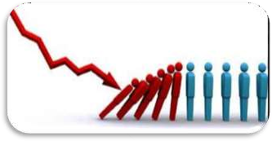




RIGHTSIZING
Employing & Maintaining exact number of employees with required skills, abilities and knowledge to perform the existing number of jobs in an organization
FACTORS RESULTED IN RIGHTSIZING ARE:
Competition
Information
Technology
Technological
Innovation
Multiskills

Slide 8
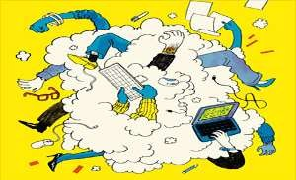

NEED FOR RIGHTSIZING
To have exact number of employees as per the
job analysis,
job description and
job specification exercise of the company.
To reduce dysfunctional activities of employees.
To minimize the cost of human resources and to increase the production cost by eliminating unnecessary costs.
To reduce maintenance activities of various employees, facilities and benefits of various like housing canteen, transportation, medical and recreation.
To maximize productivity by enhancing employee performance.
To avoid formation of trade union and it’s consequences.

Slide 9
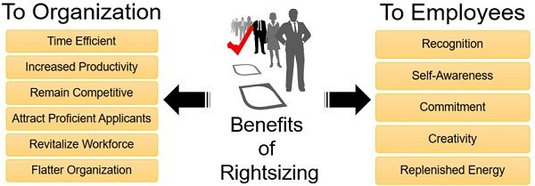
Benefits of Rightsizing

Slide 10
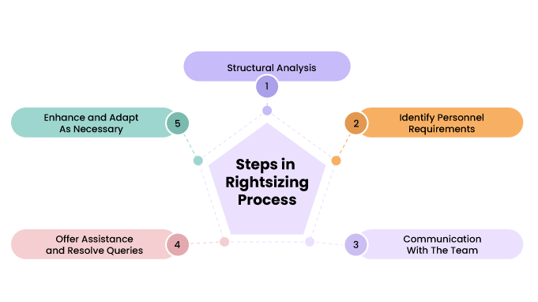

Slide 11
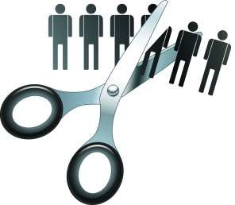
Downsizing
It means “to make (a companyor organization) smaller by reducing staff or workplace resources.
Impact of Downsizing
Survivor’s Outcomes:
Fear, insecurity and uncertainty
Frustration, resentment & anger
Sadness, depression & guilt
Unfairness, betrayal & distrust
Organisational Outcomes:
Decrease in employee morale
Reduced employee motivation and risk taking ability
Decrease in organisational productivity
Downsizing

Slide 12

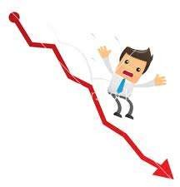

Role of HR in Downsizing
Use of alternatives such as work-sharing, down-grading, redeployment.
HR personnel must ensure proper communications to minimize the negativity and should keep each individual informed with factual data.
They should convince trade unions and win their support for downsizing.
They need to deal with layoff employees uncertainties such as service pay, retirement benefit, search for alternative job, transition assistance etc.

Slide 13
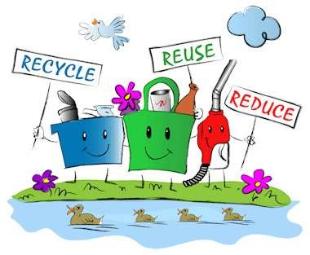
Smartsizing
Maximize the production with the help of efficient utilization of available resources using different alternatives which are economically sound.
Minimum wastage
Reutilization of waste material
Reduction in operation cost,
Lack of innovation,
Reduction in maintenance cost,
Utilization of energy saving methods to reduce cost.
Cutting down on amenities and employee programs, such as gym memberships, company cars, and cafeteria services.
Economizing the business can help reduce waste, while at the same time potentially allowing the preservation of more jobs.

Slide 14






SABBATICAL (leave without pay)
Extended leave of absence granted to employees for renewal purpose
Offer 4 to 6 months service leaves that allows manager and executives to perform special service with nonprofit organisations.

Slide 15
BENEFITS
COMPANIES
INDIVIDUAL
Retain Valued Employees
Attract Top Talent
Increase Productivity
Develop High Potentials
Revitalize Your Workforce
Get Great Public Relations
Self-Awareness
Replenished Energy
Renewed Commitment
A Surge of Creativity
The Ability to Inspire
Increased Confidence

Slide 16
Q & A Session

